Slide 1
School-to-Prison Pipeline Data
July 19, 2024

Slide 2
Methodology
Datasets used:
NYPD School Safety Act (SSA) Reports on NYPD-involved disciplinary incidents
Department of Education (DOE) suspension reports
Analyzed 2022-2023 academic year
  Most recent DOE reports included data from the school year 2022-23
  The most recent NYPD reports included data from 2024 Q1. We chose to use Q4 2022 through Q2 2023 data to replicate the DOE’s 2022-23 school year timeframe.
We excluded non-traditional schools (i.e., transfer schools, charter schools, etc.) from our analysis for uniformity purposes

Slide 3
Overall Takeaways
The NYPD’s SSA Reports suggest disproportionate targeting of Black and Hispanic students by punitive measures, both citywide and in the Bronx:
  Black students make up 20% of total city-wide enrollment, but 49% of total SSA reports.
  Black students make up 24% of total Bronx enrollment, but 43% of total Bronx SSA reports.
The SSA data suggest Bronx public schools are more heavily policed than other boroughs:
  Bronx students make up 19% of total city-wide enrollment, but 25% of total SSA reports.
The New York City Department of Education’s (DOE) School Suspension Reports show NYPD-involved removals occur almost exclusively in schools with high poverty rates and few White students

Slide 4
Analysis of SSA Reports
Source: 2022 Q4 - 2023 Q2 data from NYPD SSA (School Safety Agent) Reports

Slide 5
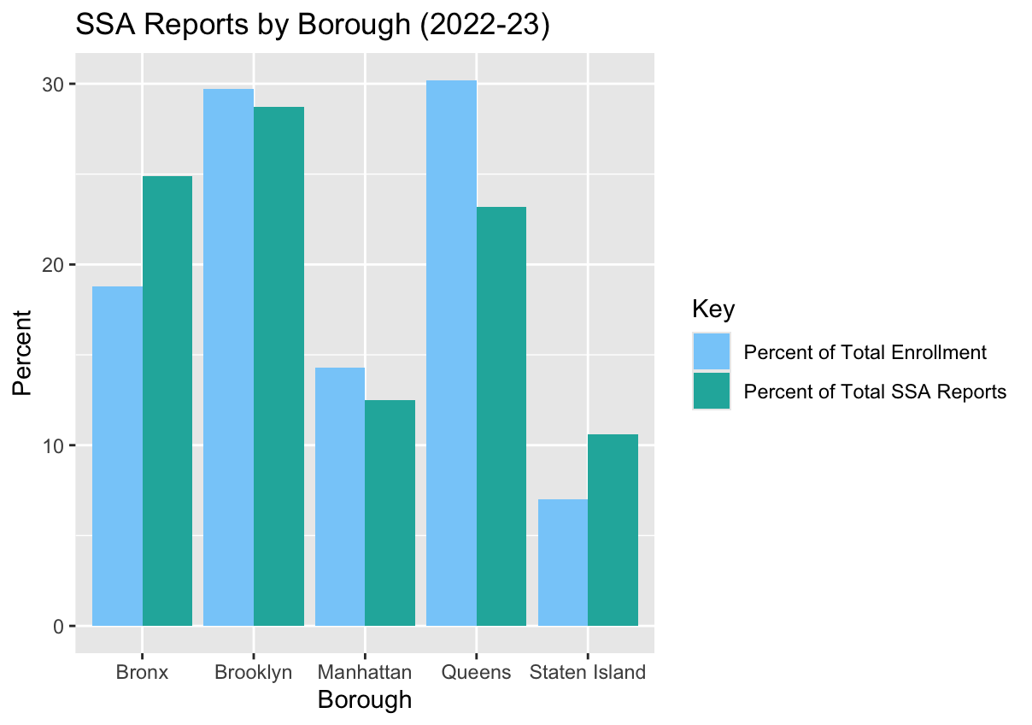
Analysis of Citywide SSA Reports by Borough
This bar plot compares the five boroughs’ proportion of total city-wide enrollment with their proportion of SSA reports.
Students in the Bronx are disproportionately targeted by SSA reports, as they make up 19% of total city-wide enrollment, but 25% of total SSA reports.

Slide 6
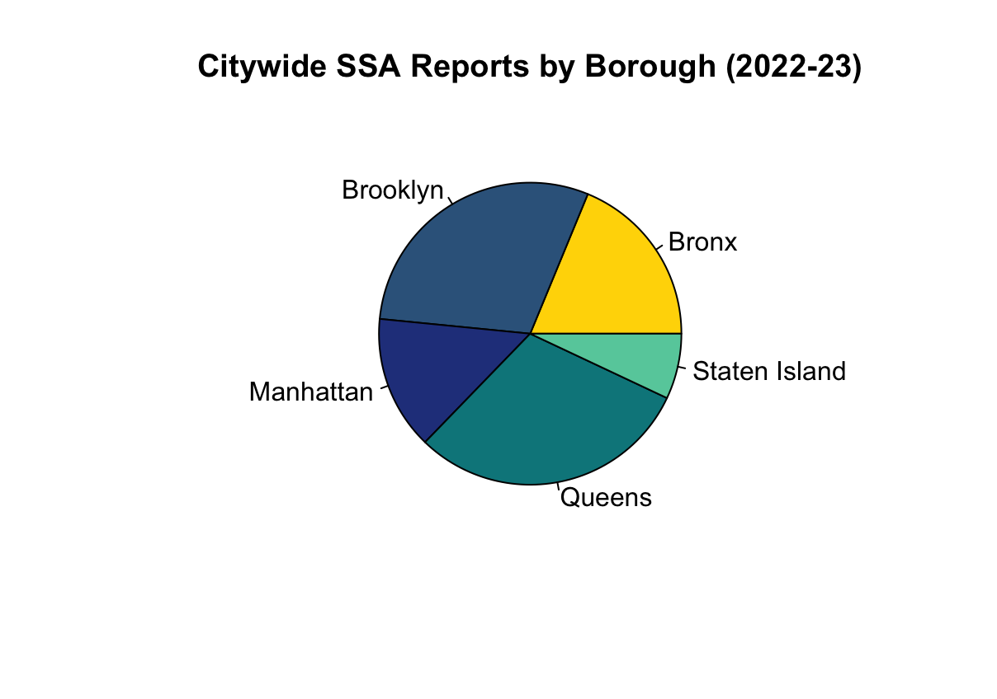
Citywide SSA Reports by Borough (Pie Charts)

Slide 7
Citywide SSA Reports by Borough (Table)
Borough | Total Enrollment | % of Total Enrollment | Total SSA Reports | % of Total SSA Reports
Bronx | 170,262 | 19% | 3,155 | 25%
Brooklyn | 269,044 | 30% | 3,636 | 29%
Manhattan | 129,942 | 14% | 1,581 | 13%
Queens | 274,177 | 30% | 2,940 | 23%
Staten Island | 63,552 | 7% | 1,341 | 11%
TOTAL | 906,977 |  | 12,653

Slide 8
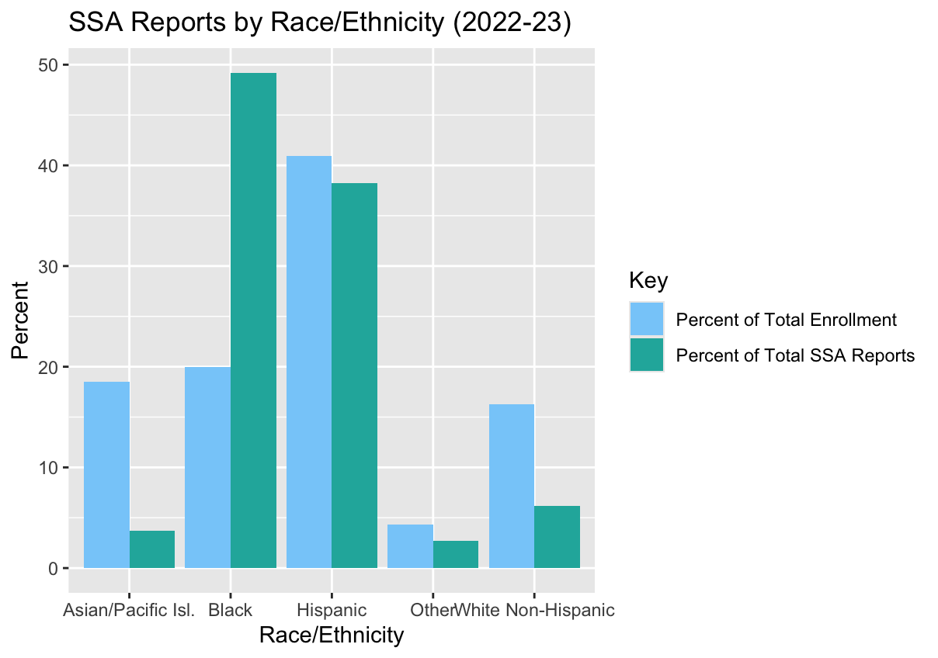
Analysis of Citywide SSA Reports by Race/Ethnicity
This bar plot compares different racial demographics’ proportion of total city-wide enrollment with their proportion of SSA reports.
Black students are disproportionately targeted by SSA reports, as they make up 20% of total city-wide enrollment, but 49% of total SSA reports.
White Non-Hispanic and Asian students are disproportionately excluded from SSA reports, as they make up 16% and 19% of total city-wide enrollment, but only 6% and 4% of total SSA reports (respectively).

Slide 9
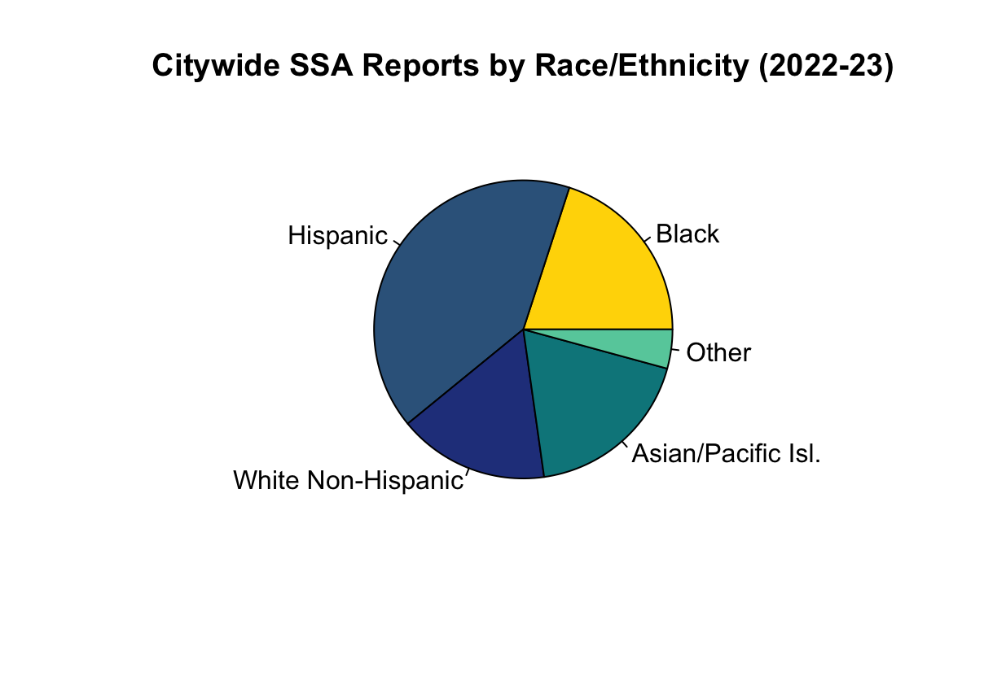
Citywide SSA Reports by Race/Ethnicity (Pie Charts)

Slide 10
Citywide SSA Reports by Race (Table)
Race/Ethnicity | Total Enrollment | % of Total Enrollment | Total SSA Reports | % of Total SSA Reports
Black | 181,396 | 20% | 6,229 | 49%
Hispanic | 371,001 | 41% | 4,827 | 38%
White Non-Hispanic | 148,103 | 16% | 783 | 6%
Asian/Pacific Isl. | 168,042 | 19% | 468 | 4%
Other | 38,435 | 4% | 346 | 3%
TOTAL | 906,977 |  | 12,653

Slide 11
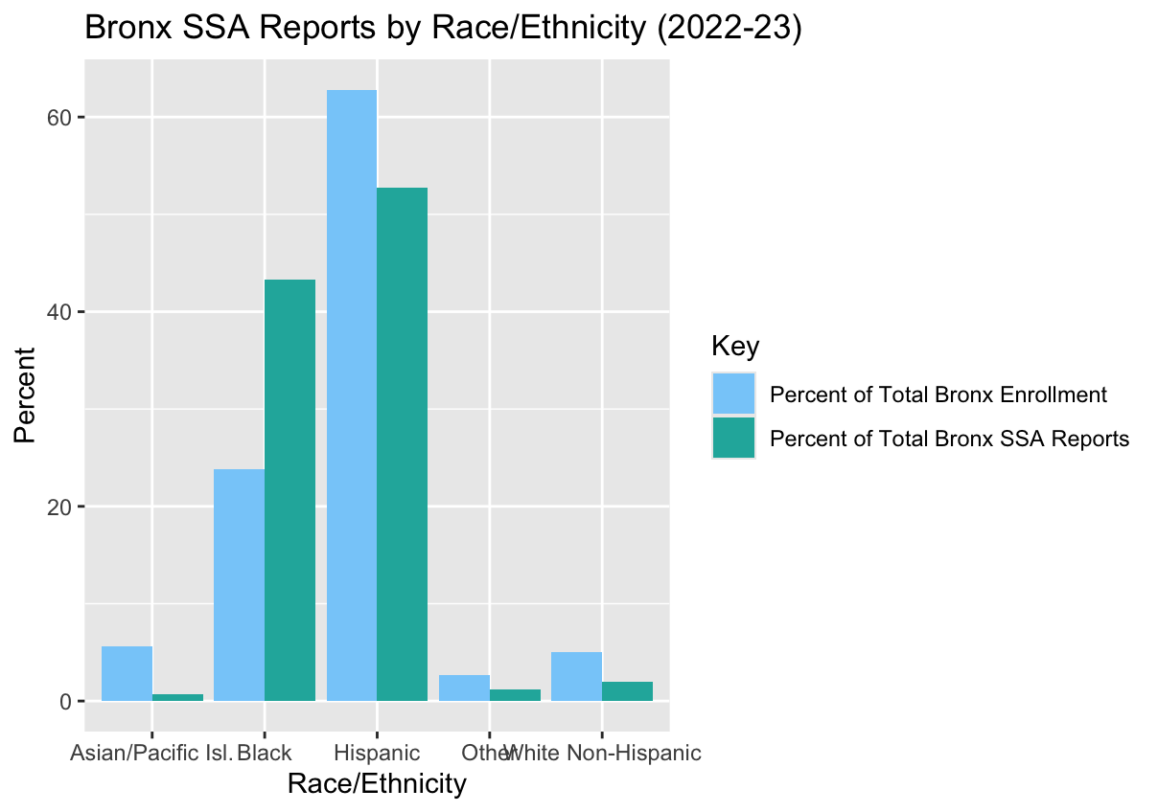
Analysis of Bronx SSA Reports by Race/Ethnicity
This bar plot compares different racial demographics’ proportion of total Bronx enrollment with their proportion of SSA reports.
Black students are disproportionately targeted by SSA incidents, as they make up 24% of total Bronx enrollment, but 43% of total Bronx SSA reports.
White Non-Hispanic and Asian students are disproportionately excluded from SSA reports, as they make up 5% and 6% of total Bronx enrollment, but only 2% and 1% of total Bronx SSA reports (respectively).

Slide 12
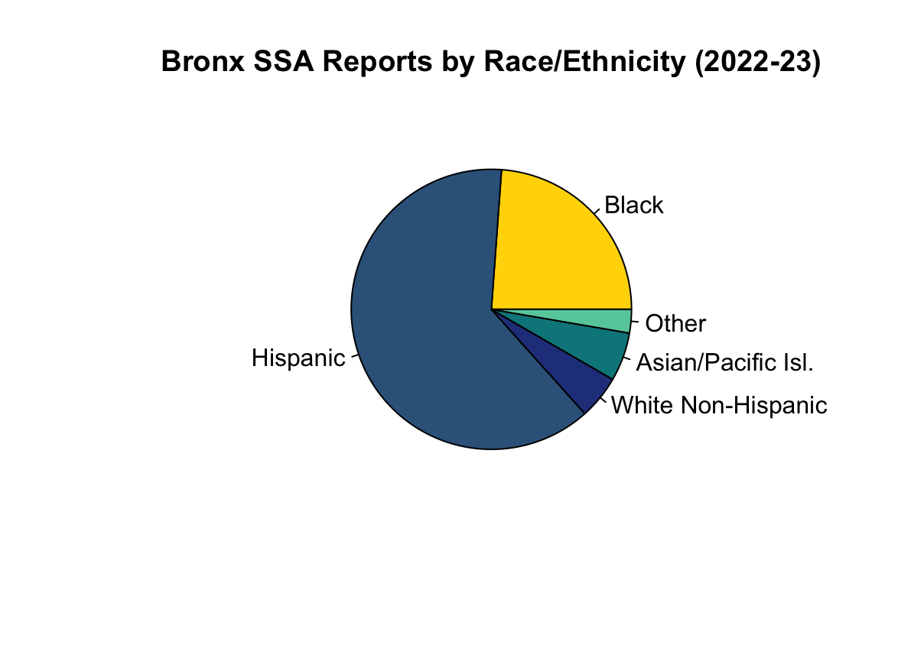
Bronx SSA Reports by Race/Ethnicity (Pie Charts)

Slide 13
Bronx SSA Reports by Race (Table)
Race/Ethnicity | Total Bronx Enrollment | % of Total Bronx Enrollment | Total Bronx SSA Reports | % of Total Bronx SSA Reports
Black | 40,591 | 24% | 1,368 | 43%
Hispanic | 106,889 | 63% | 1,664 | 53%
White Non-Hispanic | 8,585 | 5% | 63 | 2%
Asian/Pacific Isl. | 9,571 | 6% | 21 | 1%
Other | 4,626 | 3% | 39 | 1%
TOTAL | 170,262 |  | 3,155

Slide 14
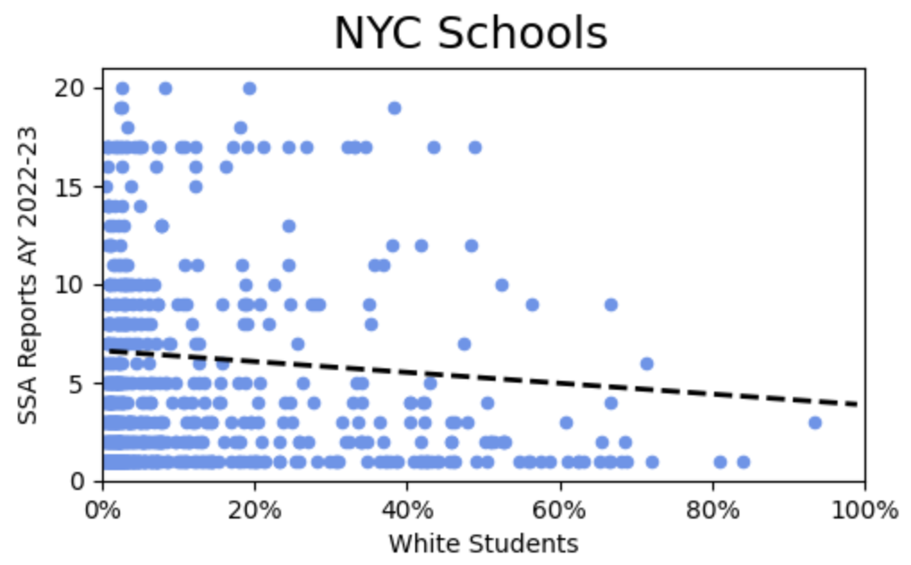
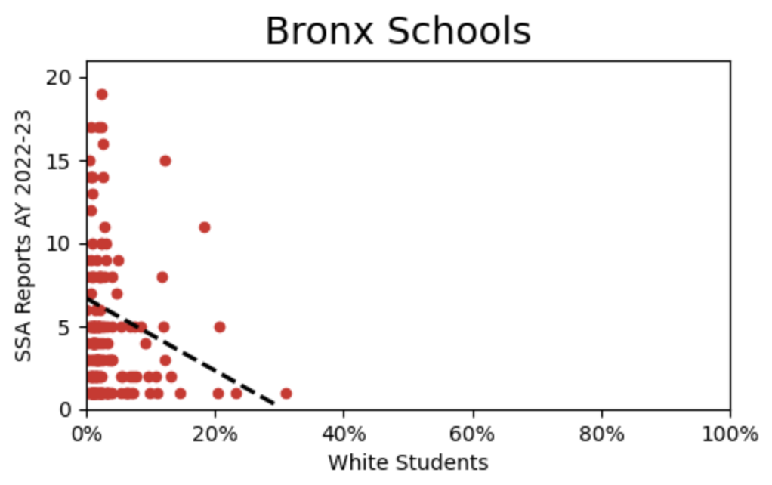
SSA Reports vs % White Students
NYC and Bronx schools with smaller proportions of White students tend to have more SSA reports

Slide 15
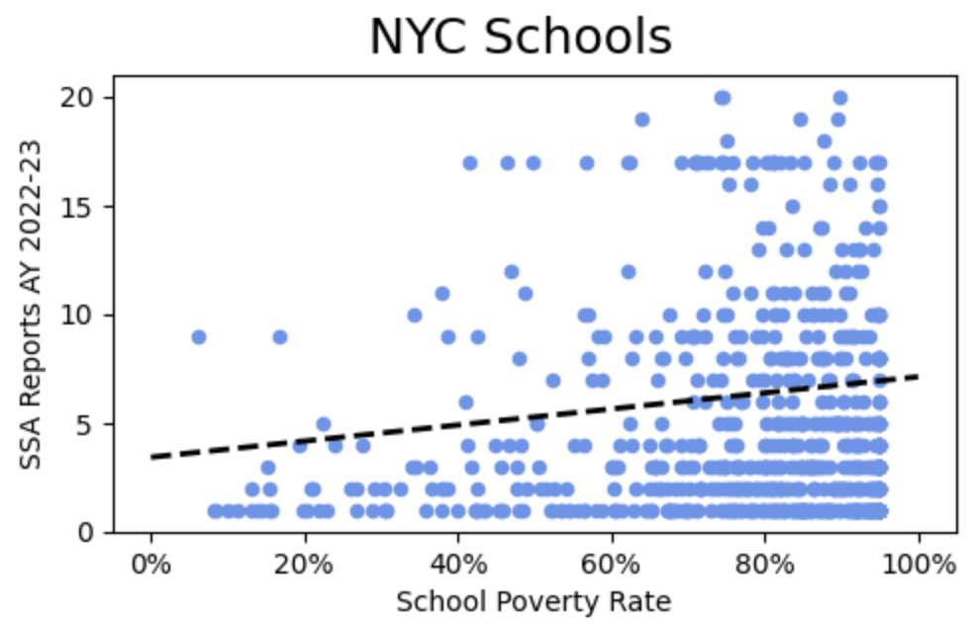
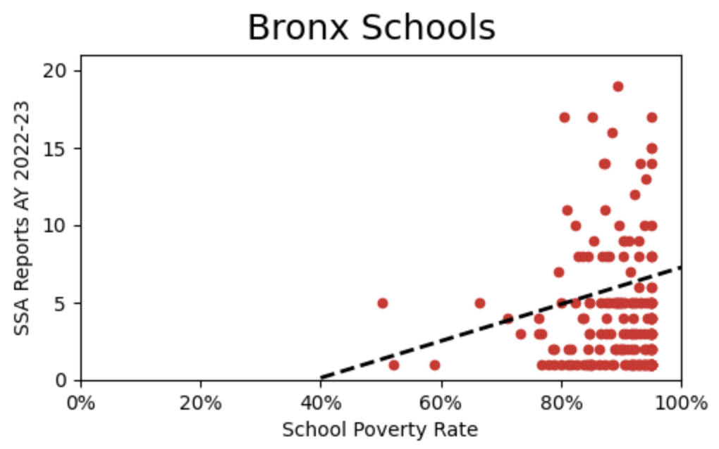
SSA Reports vs School Poverty Rates
NYC and Bronx schools with greater proportions of students experiencing poverty tend to have more SSA reports

Slide 16
Analysis of Student Discipline Reports
Source: 2022-23 data from NYCED Suspension Reports

Slide 17
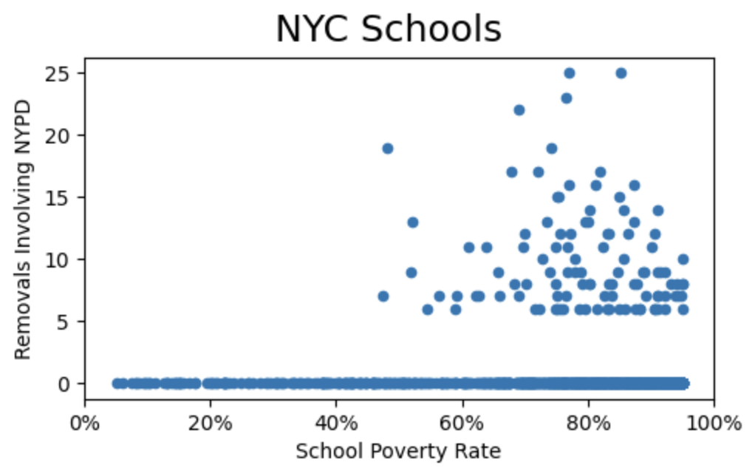
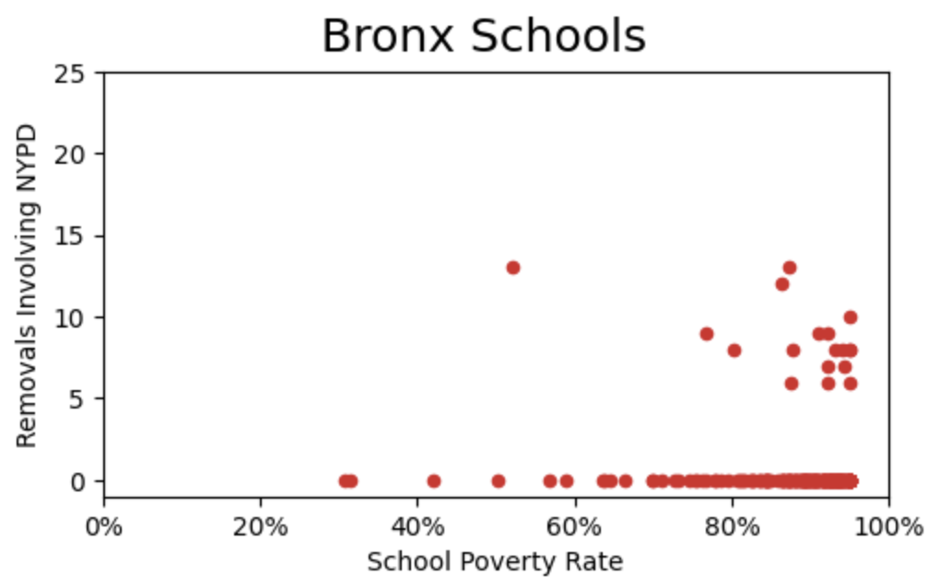
NYPD Removals vs School Poverty Rates
At least 47% of students experience poverty in all DOE schools with at least 5 NYPD-involved removals
DOE redacts schools with 1-4 NYPD-involved removals

Slide 18
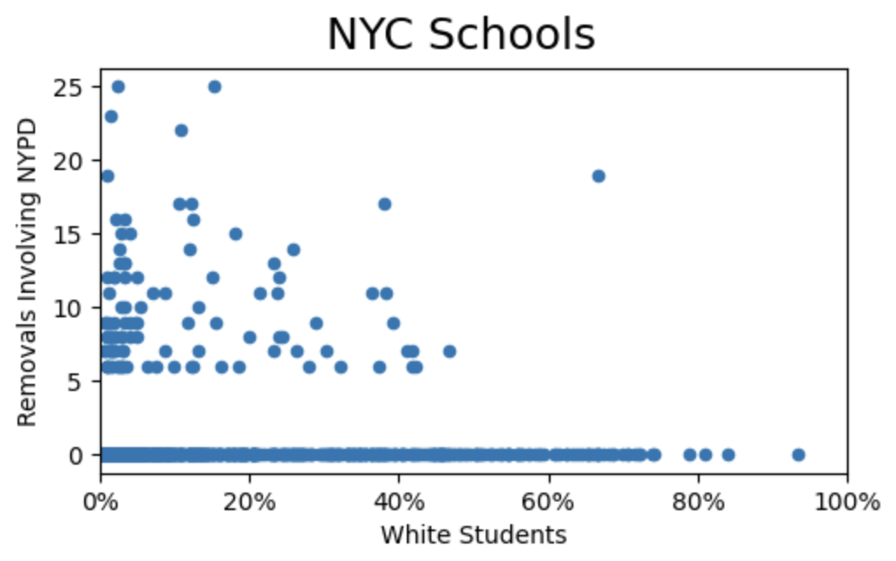
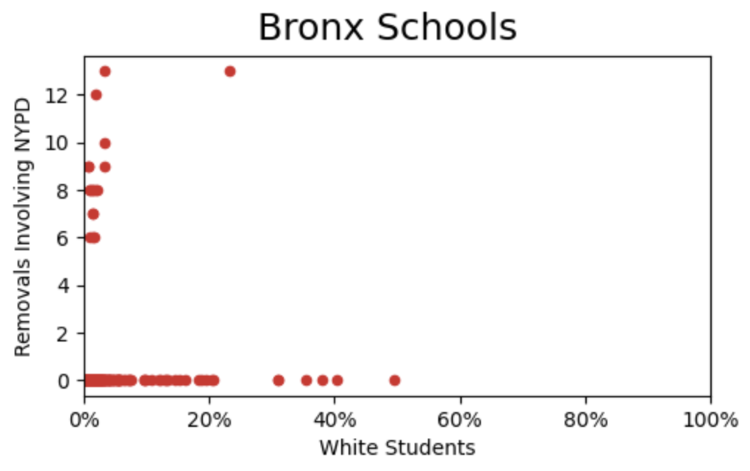
NYPD Removals vs % White Students
White students comprise less than 50% of the student body at most NYC schools and less than 10% of most Bronx schools with at least 5 NYPD-involved removals
Notes:
X axis?

Slide 19
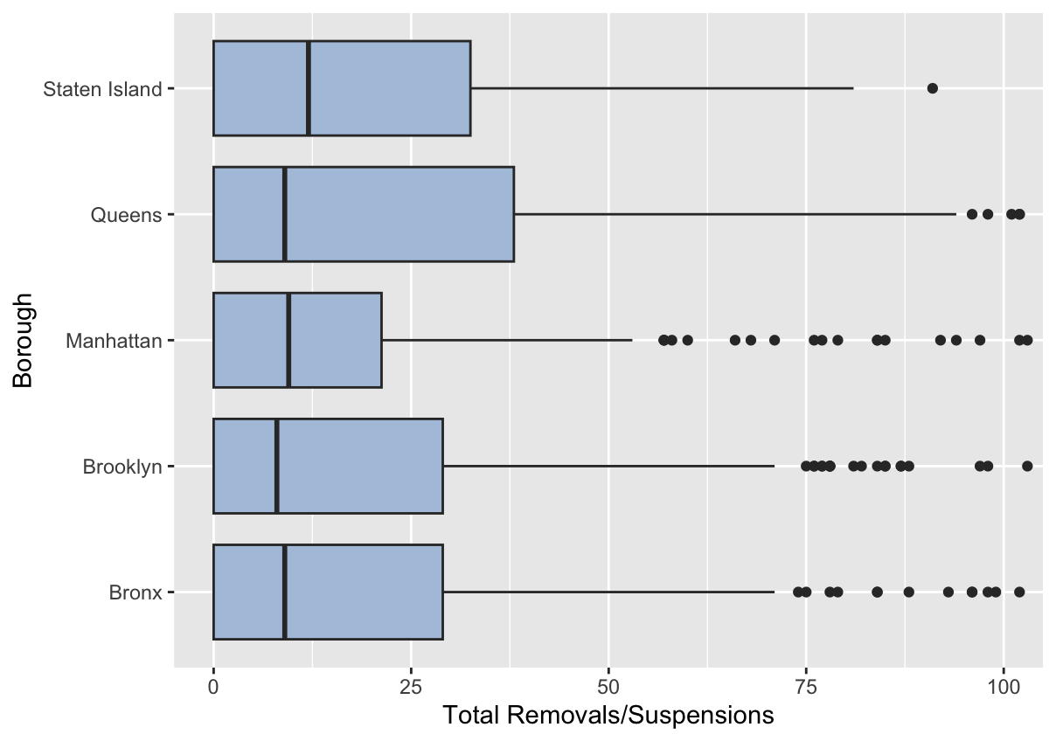
Analysis of Student Discipline by Borough
This boxplot compares the suspension/removal counts across different public schools in each borough.
No appearable differences in the number of suspensions and removals in individual schools across the boroughs
  Medians are roughly equivalent

Slide 20
Student Discipline by Borough (2022-2023)
Borough | Total Enrollment | Total Removals/Suspensions | Total Removals/Suspensions Where NYPD Was Contacted | % of Total Removals/Suspensions to Total Enrollment | % of Total Removals/Suspensions Where NYPD Was Contacted to Total Removals/Suspensions
Bronx | 170,262 | 7,415 | 155 | 4.4% | 2.1%
Brooklyn | 269,044 | 10,122 | 304 | 3.8% | 3.0%
Manhattan | 129,942 | 5,193 | 88 | 4.0% | 1.7%
Queens | 274,177 | 9,829 | 383 | 3.6% | 3.9%
Staten Island | 63,552 | 3,538 | 152 | 5.6% | 4.3%
Notes:
Data does not include charter schools.
Redacted values ignored in calculations.

Slide 21
Possible Restorative Justice Solutions

Slide 22
Restorative Justice & School-to-Prison Pipeline
Source: https://www.tandfonline.com/doi/full/10.1080/10282580.2018.1455509
“Cole Middle School in Oakland, CA experienced a significant 87% decrease in suspensions and reported no expulsions following the adoption of a whole-school restorative justice approach.
Restorative practices in 17 schools in Denver, CO led to a 68% decrease in police tickets overall, a 40% decrease in out-of-school suspensions, and an 82% decrease in expulsions.
Through restorative circles, conferences, peer mediation, and other restorative methods, the Minnesota Department of Education achieved a reduction in behavioral referrals and suspensions, ranging from 45 to 65 percent, as well as an increase in academic achievement in 2 schools.
After introducing several restorative practices, school exclusions were notably reduced in 14 out of 18 public schools in Scotland.”

Slide 23
Next Steps
& Additional Data

Slide 24
Next Steps:
Locate data and perform analysis on charter schools and other non-DOE schools
Determine if schools with high proportions of disabled students are more heavily policed

Slide 25
Raw Data/Sources:
NYCED School Metadata
NYCED Demographic Data (under “Demographic Snapshot”... includes “% Poverty” and “Economic Need Index” values)
NYCED Suspension Reports (under “Student Discipline” and “NYPD Contacts that Resulted in Suspension”)
NYPD SSA (School Safety Agent) Reports (we looked at 2022 Q4 - 2023 Q2 data)

